Slide 1
03
Discrete Mathematics
Constructing A Truth Table for Compound Propositions

Slide 2

Compound Proposition Truth Table Walk-Thru
Rows
Need a row for every possible combination of values for the compound propositions.
Columns
Need a column for each propositional variable
Need a column for the truth value of each expression that occurs in the compound proposition as it is built up
Need a column for the compound proposition (usually at far right)
Order of Operations
Precedence | Operator
1 | $$¬$$
2 | $$∧$$
3 | $$∨$$
4 | $$→$$
5 | $$↔$$

Slide 3

Compound Proposition Truth Table Walk-Thru
Construct a truth table for $p∨q→¬r$
First, construct columns for each proposition; $p, q, r$ (these may be referred to as atomic propositions)
Next, create a column for each compound proposition; $p∨q , ¬r$
Lastly, create a column for the final compound proposition
$$p$$ | $$q$$ | $$r$$
$$p$$ | $$q$$ | $$r$$ | $$p∨q$$ | $$¬r$$
$$p$$ | $$q$$ | $$r$$ | $$p∨q$$ | $$¬r$$ | $$p∨q→¬r$$

Slide 4
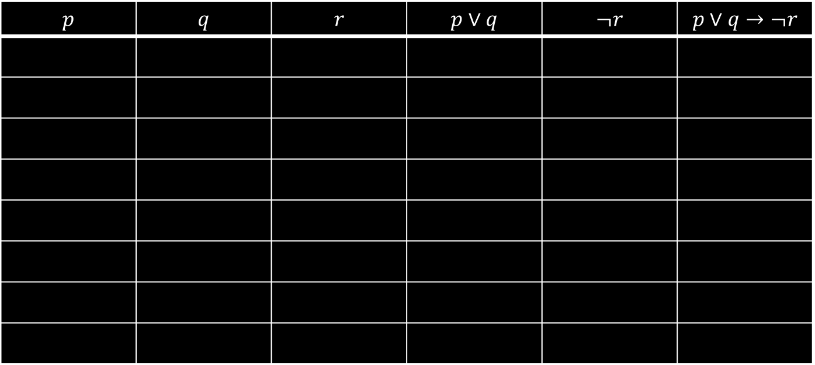

Compound Proposition Truth Table Walk-Thru
Now create as many rows as necessary for all possible combinations of expressions that occur in your compound proposition. Because we have 3 propositions, we need $2^{3}=8$ rows.
$$p$$ | $$q$$ | $$r$$ | $$p∨q$$ | $$¬r$$ | $$p∨q→¬r$$

Slide 5
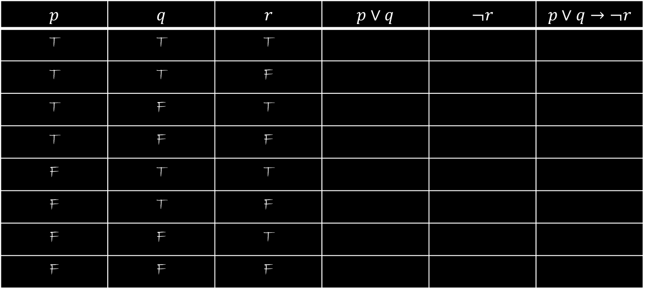
Compound Proposition Truth Table Walk-Thru
Fill in the truth table for your propositions first. Now complete the table. Try it on your own first!
$$p$$ | $$q$$ | $$r$$ | $$p∨q$$ | $$¬r$$ | $$p∨q→¬r$$
T | T | T
T | T | F
T | F | T
T | F | F
F | T | T
F | T | F
F | F | T
F | F | F

Slide 6
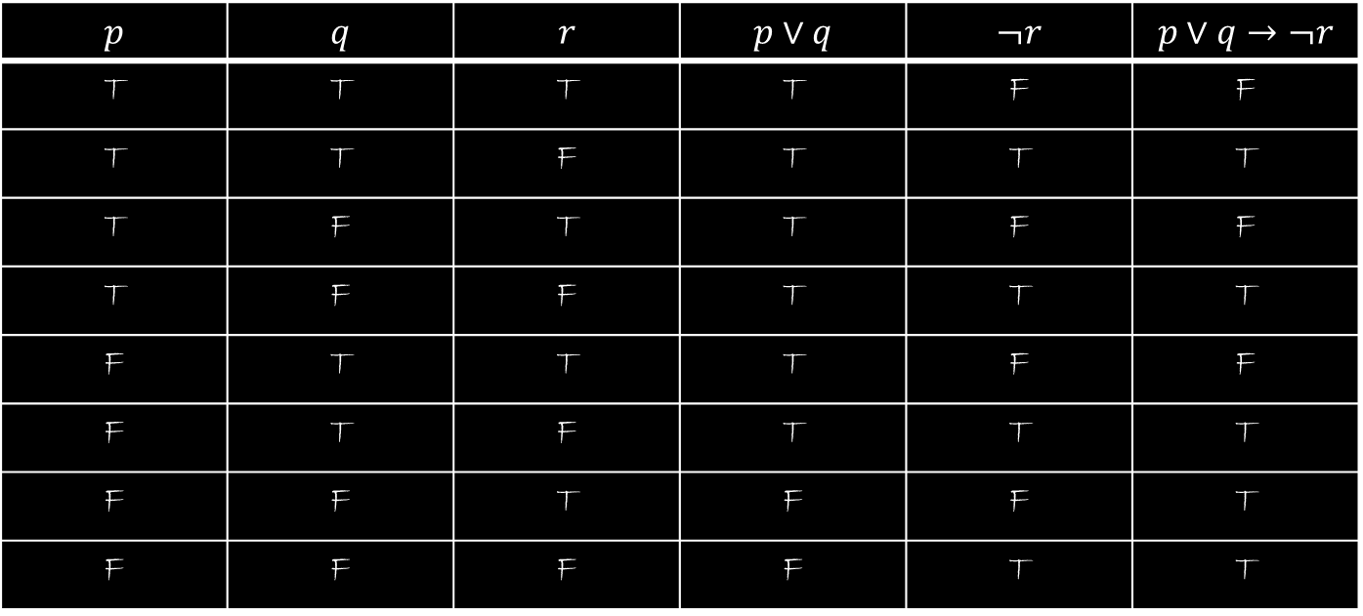
Compound Proposition Truth Table Walk-Thru
Here is your final solution:
$$p$$ | $$q$$ | $$r$$ | $$p∨q$$ | $$¬r$$ | $$p∨q→¬r$$
T | T | T | T | F | F
T | T | F | T | T | T
T | F | T | T | F | F
T | F | F | T | T | T
F | T | T | T | F | F
F | T | F | T | T | T
F | F | T | F | F | T
F | F | F | F | T | T

Slide 7

Practice
Create a truth table for $\left(p∨¬q\right)→\left(p∧q\right).$

Slide 8
Up Next…
Translating Propositional Logic Statements

